Slide 1
Just Note

Slide 2
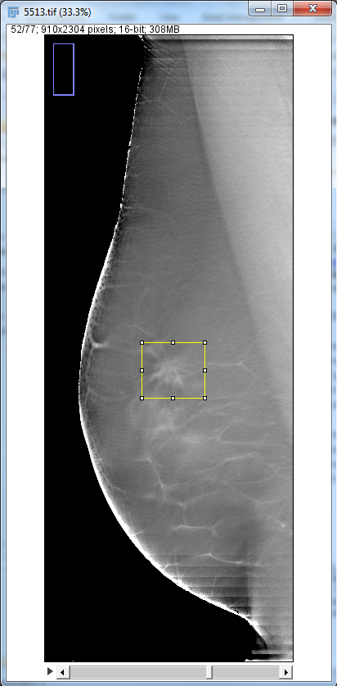
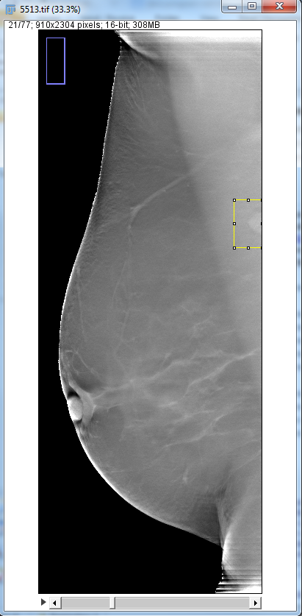
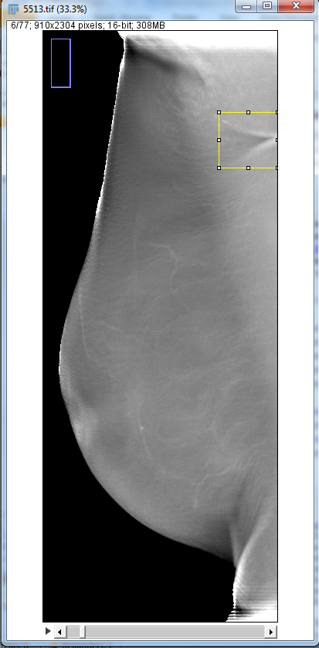
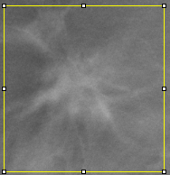
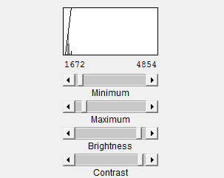
skin fold
benign lymph
lesion

Slide 3
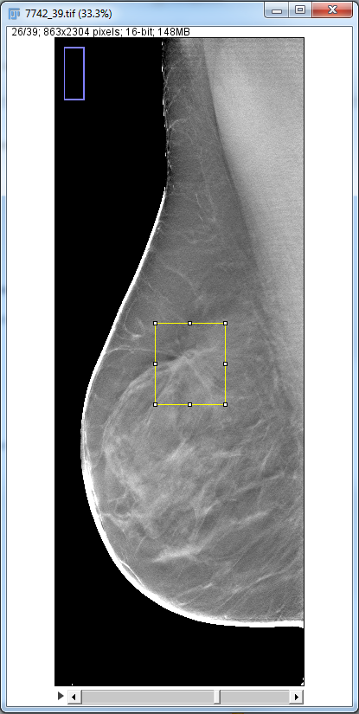
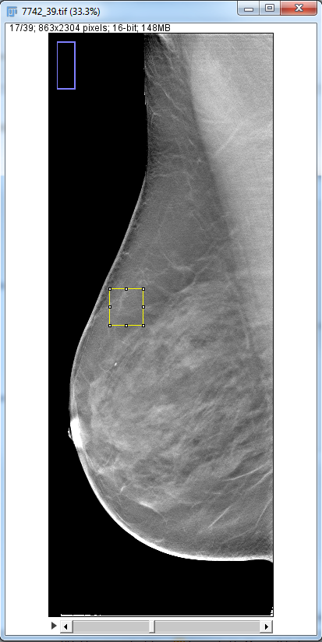
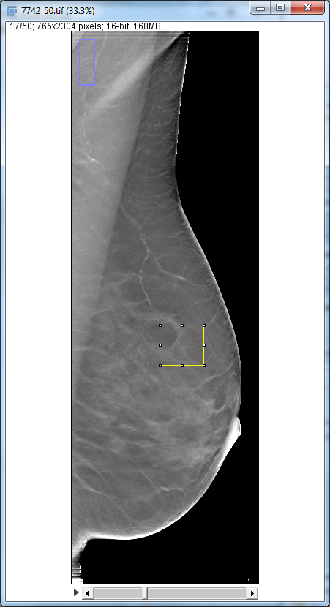
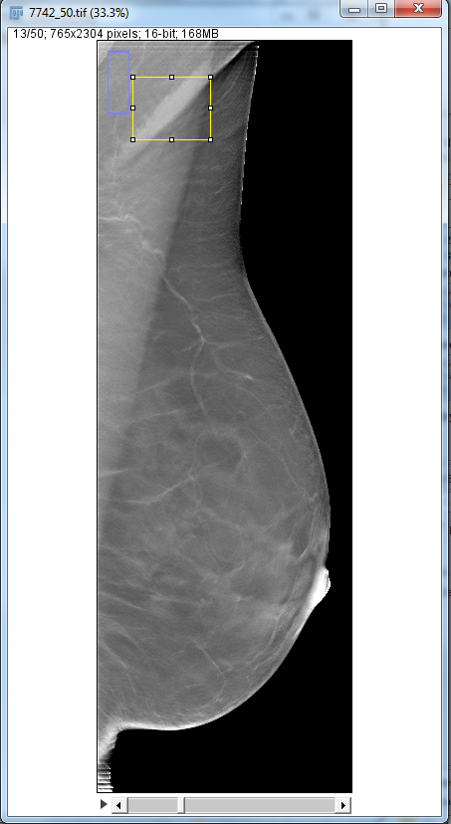
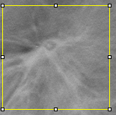
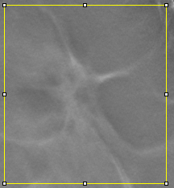
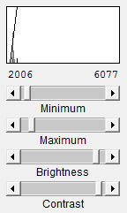
skin fold
arterial vascular
calcifications
lesion
questionable

Slide 4
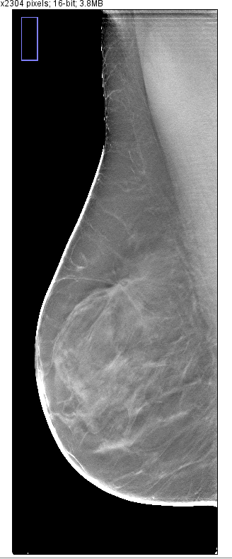

Slide 5
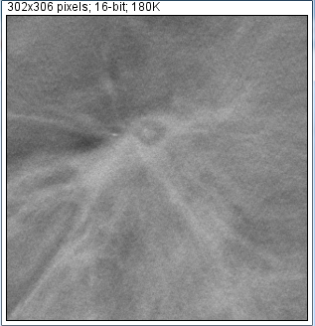
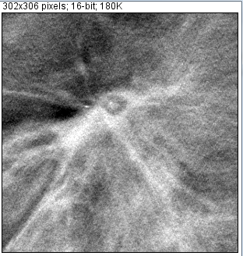
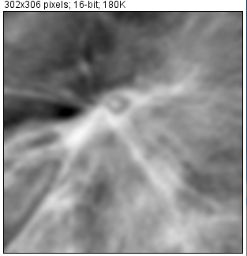
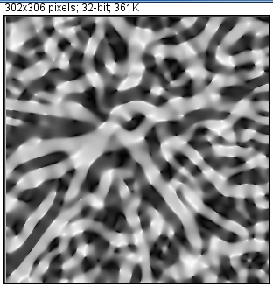
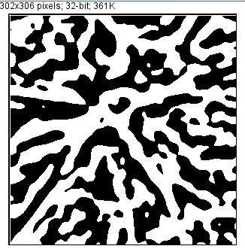
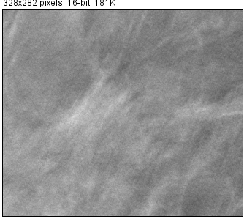
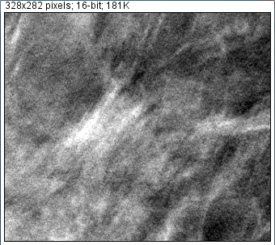
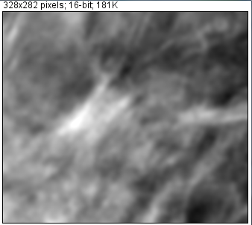
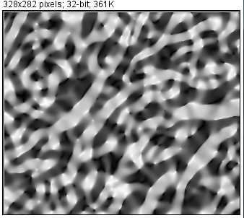
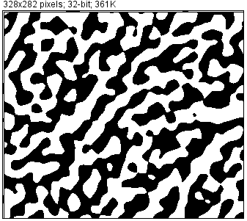
Local contrast enhancement
Smoothing
Shape index mapping
Binarization
http://homepages.inf.ed.ac.uk/rbf/CVonline/LOCAL_COPIES/WORTHINGTON/node6.html

Slide 6
Using Eigenface technique
Database
Eigenmass
(diff scales, diff shapes)
Region of Interests
Scan & Match
Extract
Fuzzy Classify
Not based on original intensity, but preprocessed (binary)
Lesion Questionable Normal

Slide 7
Breast cancer characteristics
Architecture Distortion
Normal breast is oriented textured converged to the nipple,
Due to the presence of ligament, duct, and vessels
Approaches:
Gabor Filter
Fractal Dimension
Concentration Index
Phase Portrait Modeling
Wavelet

Slide 8
Calcification detection
Hessian filter bank:
SNR enhancement
Comparing responses:
Equal eigenvalues/biased eigenvalues

Slide 9
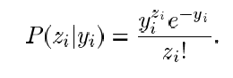
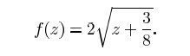
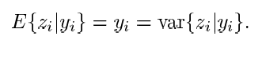
Denoising
X-Ray Quantum noise:
Poisson Distribution: noise is data dependence
Gaussian Distribution: additive, noise independent
Anscombe
Transform
Poisson Distribution
Gaussian
Distribution
unitary variance
* Variance stabilizing transform

Slide 10
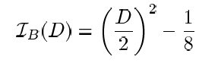
Anscombe
Transform
Poisson Distribution
Gaussian
Distribution
unitary variance
Adaptive Winier
Filter
Inverse Anscombe
Transform
Denoised
Images

Slide 11
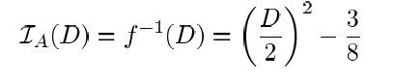
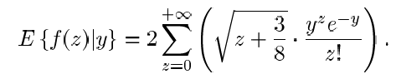
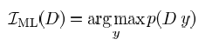
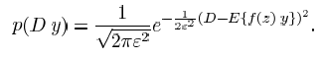
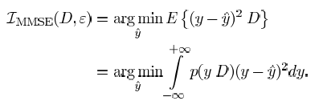
Denoising
Inverse Anscombe transform
* Numerical Inverse
* Practical Inverse
* Unbiased Inverse
* ML Inverse
* MMSE Inverse

Slide 12
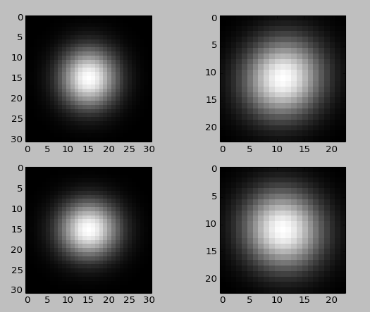
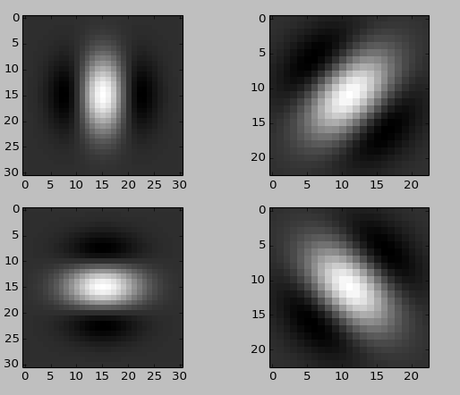
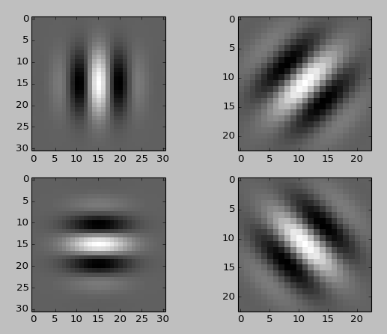
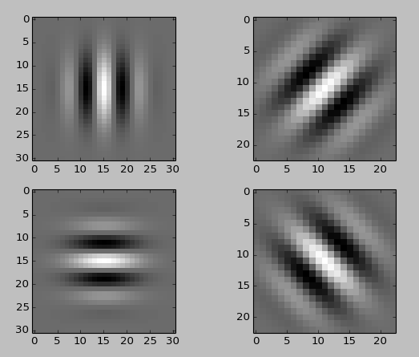
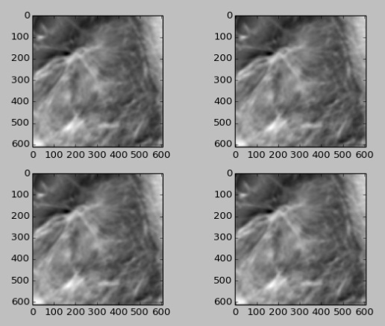
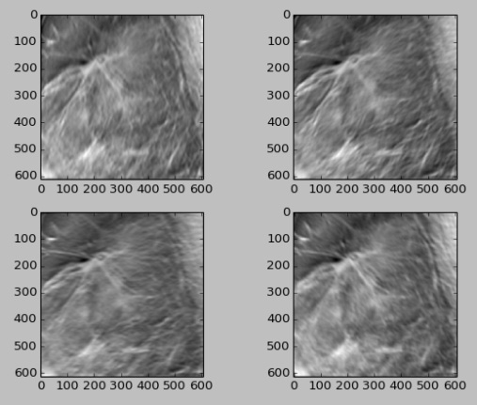
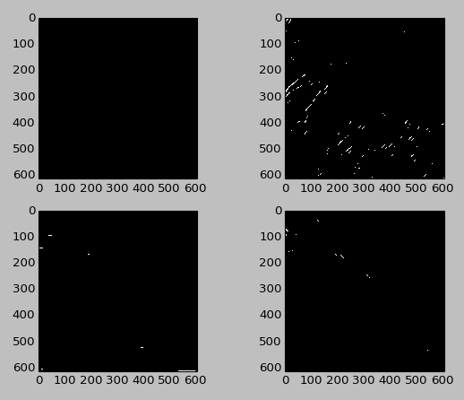
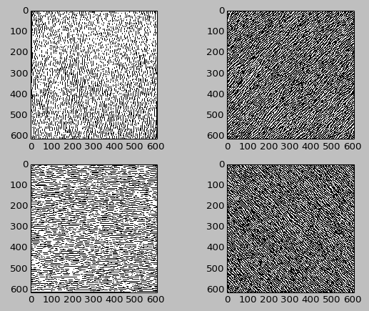
Gabor Filters
(4, 5, 0.01,1)
(4, 5, 0.05,1)
(4, 5, 0.1,1)
(4, 5, 0.125,1)

Slide 13
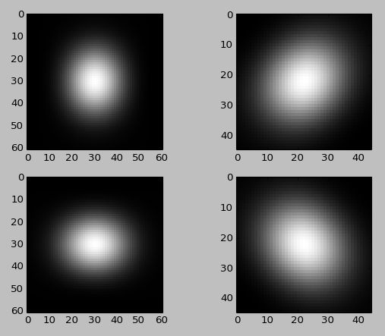
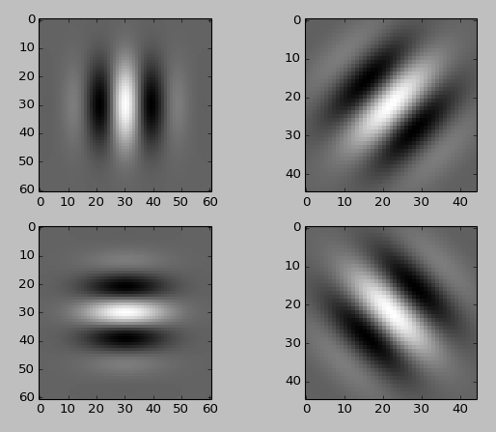
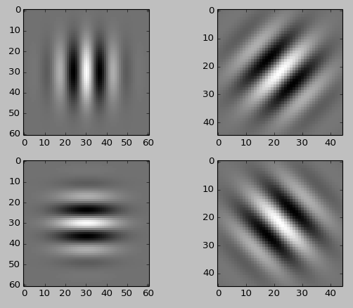
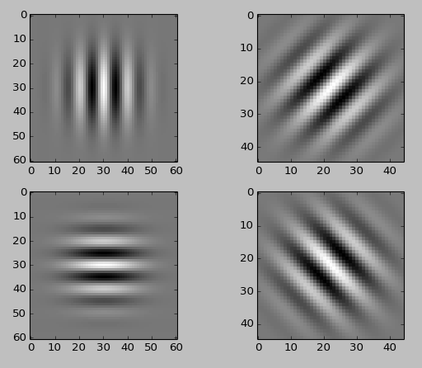

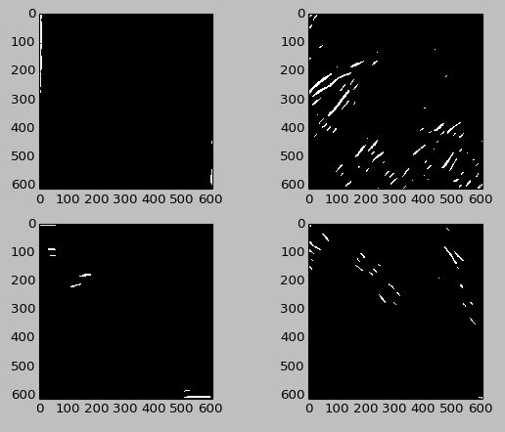
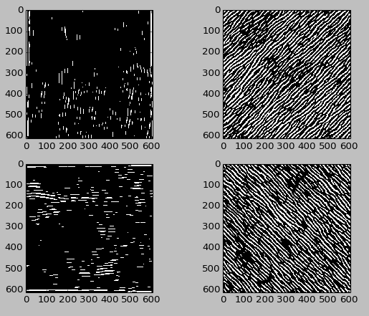
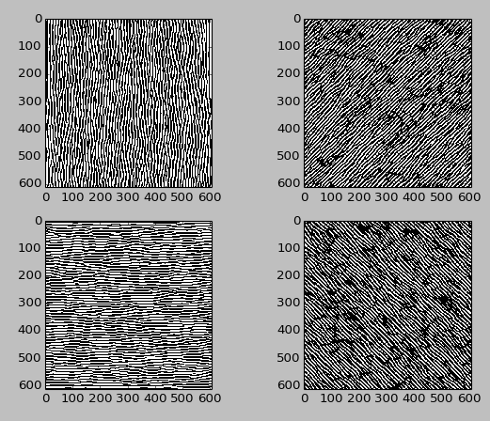
Gabor Filters
(4, 10, 0.01,1)
(4, 10, 0.05,1)
(4, 10, 0.075,1)
(4, 10, 0.1,1)

Slide 14
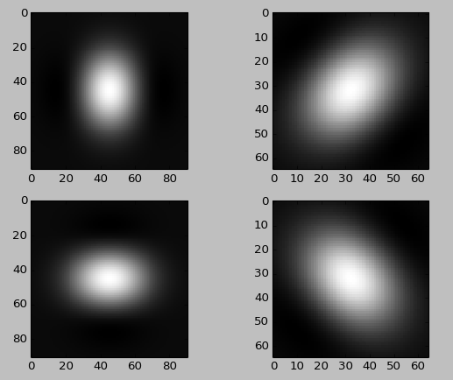
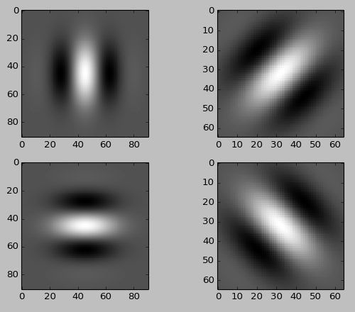
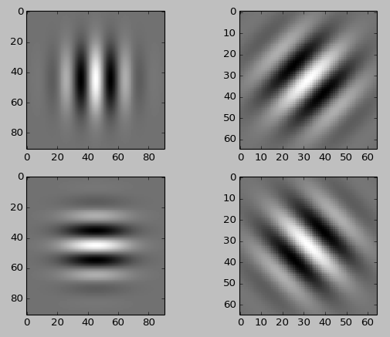



Gabor Filters
(4, 15, 0.01,1)
(4, 15, 0.025,1)
(4, 15, 0.05,1)

Slide 15








Gabor Filters
(4, 20, 0.01,1)
(4, 20, 0.0175,1)
(4, 20, 0.025,1)
(4, 20, 0.05,1)

Slide 16

Windowed Response

Slide 17


Slide 18


Slide 19





Responses Poll

Slide 20



(4, 20, 0.0175,0.9)
(4, 20, 0.0185,0.9)

Slide 21

















Slide 22

















Slide 23









Slide 24












i (intensity)
center
r(radius)

Slide 25










Dimensionality Reduction

Slide 26
Work Flow
Images
Preprocessing
Mass Extraction
Calcification
Segmentation
Graph cut
Mass detection
Wavelet/gabor
Calcification Detection
LOG
Feature Extraction
Reducing False positive by classification
Feature Extraction
Refine among neighboring slices
Classification

Slide 27
Images
Preprocessing
Bilateral Asymmetric
Mass Extraction
Calcification
Initial Detection
Gabor/Wavelet
Boundary Detection
Foreground Subtraction
Control Points Selection
Level-set
Segmentation
ROI Feature Extraction
LOG
Filtering
Registration
Object Feature Extraction
3-D Constraining
Region Comparison
Classification
Multi-instance Learning

Slide 28

Micro calcification detection
Local foreground extraction
Calcifications are of high intensity(above 30%), set all other pixels to background
Avoid artificial boundary/gradient

Slide 29

Micro calcification detection
Laplacian of Gaussian filtering

Slide 30


Micro calcification detection
Binaries response
Label connect component & Constraining
Notes:
Results could be slightly different applying different threshold and constrain;
Constrain: volume, adjacent co-occurence

Slide 31

Micro calcification detection
Notes:
How to improve this?

Slide 32

Feature extraction
Intensity statistic
Statistics of each ring:
Mean
Variance
Features extracted:
Mean linear slope
Variance linear slope

Slide 33

Mean

Slide 34

Feature extraction
Gradient Statistic
Perpendicular Index
0.6 | 0.8 | . | . | . | . | . | . | . | .

Slide 35


Feature extraction
Fractal dimension
Angular power spread
Notes:
From other papers

Slide 36
Classification
SVM testing feature efficiency (2d ROIs)
 |  | Predicted class
 |  | cancer | normal
Actual class | cancer | 33 | 3 | 36
 | normal | 8 | 32 | 40
 |  | 41 | 35

Slide 37
Graph based classification(3d)
Cutting Graph
Weight Function:
intensity correlation: matrix mutual information
feature correlation: PCA distance
spatial distance: Euclidean distance
co-occurrence of others

Slide 38
Mi
Weight function:
Feature correlation: mutual information
http://www.mathworks.com/matlabcentral/fileexchange/45926-feature-mutual-information--fmi--image-fusion-metric
Image toolbox
http://www.orfeo-toolbox.org/otb/

Slide 39
Features
numR = 8
numR = 10

Slide 40

Segmentation
exact

Slide 41

Pectoral muscle detection
Gradient (1.0)+ canny(2.0) + ProbablisticHough()

